Slide 1
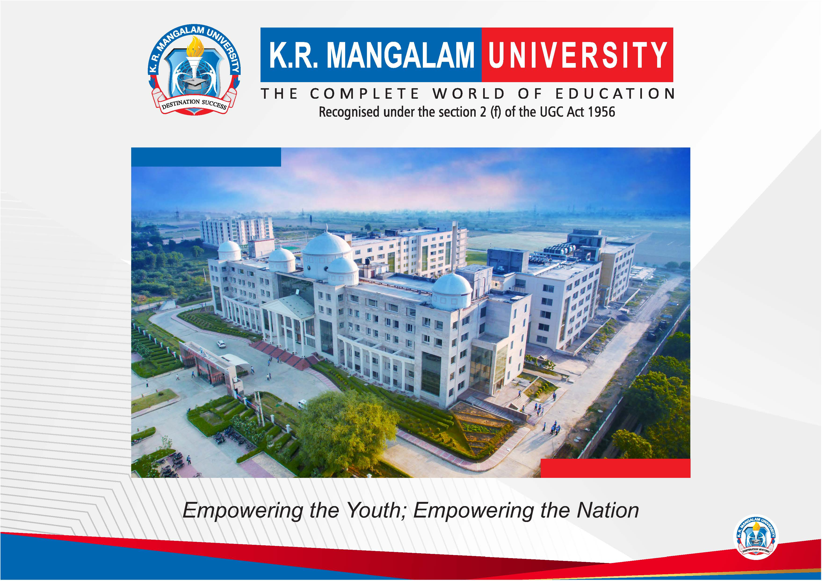

Slide 2


PREDICTIVE MAINTENANCE FOR AUTONOMOUS ELECTRIC BUSES USING REAL-TIME
SENSOR DATA AND MACHINE LEARNING
Pre-Final Year Project Synopsis
Submitted by
ROLL NO. | NAME
2401011487 | Rounit Kumar
2401011485 | Prince Kumar Gupta
2401011483 | Naman Bharadwaj
2401012482 | Shantna Kumar
Faculty Mentor: Mrs. Kriti Sharma
Notes:
New Courses replaced with New Programmes

Slide 3
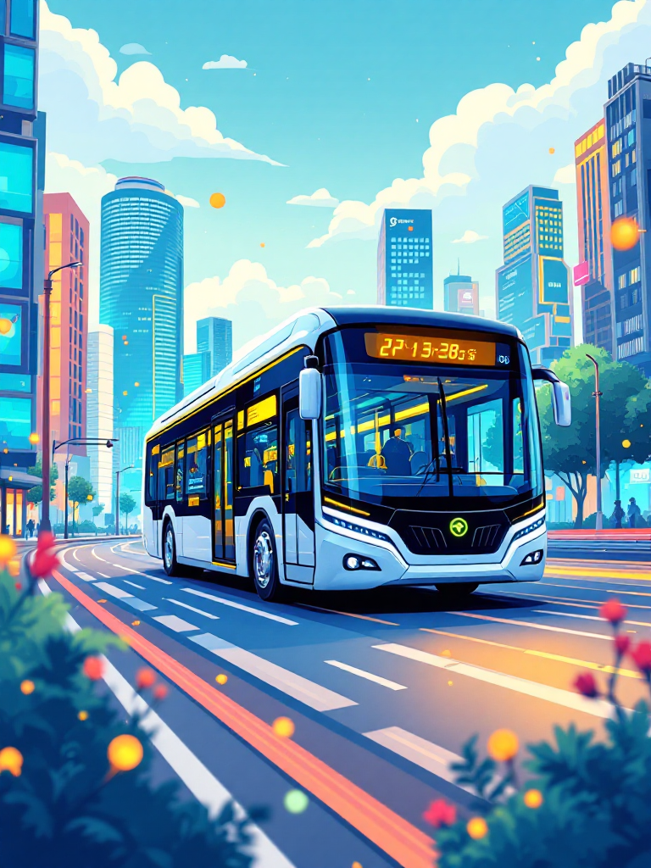

Introduction
Rapid urbanization increases demand for efficient and sustainable public transportation, promoting the adoption of Autonomous Electric Buses (AEBs).
AEBs contain complex systems, making maintenance challenging with traditional methods.
Predictive Maintenance (PdM) is studied to forecast failures and improve maintenance planning.
Real-time sensor data and machine learning are analyzed for early fault detection.
The research examines ML-based predictive maintenance approaches to improve reliability, safety, and efficiency.
Notes:
New Courses replaced with New Programmes

Slide 4
Specific Objectives
To examine the role of real-time sensor data in monitoring the health and performance of autonomous electric bus components, including battery systems, electric motors, braking systems, vibration units, and GPS modules.
To analyze data-driven fault detection methods and evaluate how machine learning algorithms can identify abnormal operational patterns that indicate potential system failures.
To study Remaining Useful Life (RUL) prediction techniques, particularly time-series models such as Long Short-Term Memory (LSTM) networks, for estimating the operational lifespan of critical components like batteries and motors.
To compare traditional maintenance strategies (reactive and preventive maintenance) with predictive maintenance approaches in terms of cost efficiency, downtime reduction, and operational effectiveness.
To assess the impact of predictive maintenance on safety, reliability, and service continuity in autonomous electric bus transportation systems.
To explore the role of centralized monitoring dashboards in supporting data-driven decision-making for fleet operators.
To evaluate the scalability of cloud-based infrastructure for managing predictive maintenance across large autonomous electric bus fleets.
Notes:
New Courses replaced with New Programmes

Slide 5
Key Features
Real-Time Sensor Data Analysis: Study how sensor data from batteries, motors, braking systems, vibration sensors, and environmental conditions can be used to monitor the health and performance of autonomous electric buses.
Machine Learning–Based Fault Analysis: Examine the use of machine learning techniques to analyze sensor data, identify abnormal patterns, and study potential indicators of system failures.
Predictive Analytics and Visualization: Investigate how predictive analytics and data visualization tools help interpret large volumes of operational data and support informed decision-making in transportation systems.
Data-Driven Maintenance Decision Support: Analyze how predictive insights derived from sensor data can assist in improving maintenance planning, optimizing resource allocation, and enhancing system reliability.
Notes:
New Courses replaced with New Programmes

Slide 6
Progress Summary
Topic Finalized: Predictive maintenance for autonomous electric buses.
Literature Review Completed: Studied existing research on predictive maintenance and machine learning techniques.
Research Gap Identified: Limited studies on integrated, real-time predictive maintenance for autonomous electric buses.
Methodology Defined: Framework for analyzing sensor data and machine learning approaches prepared.
Current Work: Studying predictive models and data analysis methods.
Next Step: Final analysis and preparation of research findings.
Notes:
New Courses replaced with New Programmes

Slide 7
Data & Resources:
Comprehensive Data Sources
Vehicle Telemetry: Study speed, acceleration, GPS location, and route data to understand bus operational behavior.
Battery System Data: Analyze state of charge, temperature, voltage, and current to examine battery health trends.
Motor & Powertrain Data: Evaluate torque, RPM, temperature, and vibration signals to study mechanical performance.
Environmental Data: Examine temperature, humidity, and road conditions affecting vehicle reliability.
Maintenance Records: Analyze historical repair logs and failure patterns to understand maintenance trends.
Technological Framework
Cloud Platforms: Study the role of Amazon Web Services and Microsoft Azure in large-scale data processing.
Database Systems: Examine structured data management using MySQL.
Data Analysis Tools: Analyze data processing using Python with NumPy and Pandas.
Machine Learning Techniques: Study predictive modeling using TensorFlow, Keras, and Scikit-learn.
Visualization Tools: Explore data interpretation through Tableau and Microsoft Power BI.
Notes:
New Courses replaced with New Programmes

Slide 8
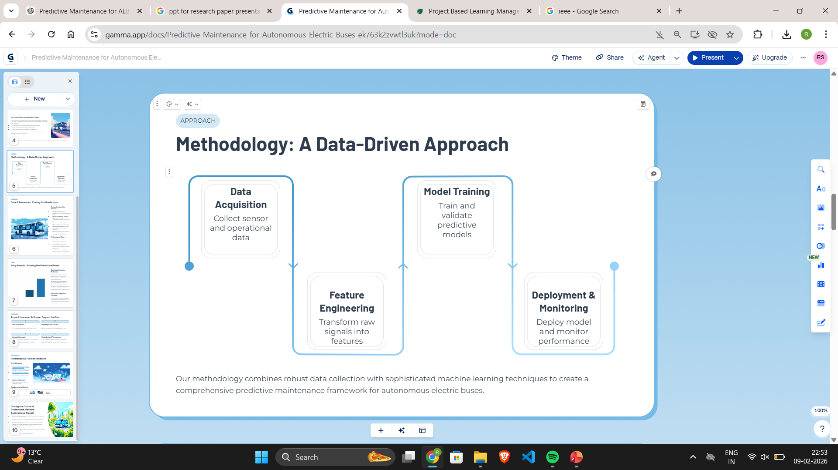
Methodology
The study examines the use of sensor-generated operational data to understand performance patterns and maintenance requirements in autonomous electric bus systems.
The research explores how machine learning techniques can be applied to analyze large volumes of sensor data and identify patterns related to system reliability and potential failures.
The study evaluates predictive maintenance approaches to understand their effectiveness in improving maintenance planning, system reliability, and operational efficiency in autonomous electric transportation systems.
Notes:
New Courses replaced with New Programmes

Slide 9
Usecases & Scope: Beyond the Bus
Smart City Integration: Examine how predictive maintenance data can support urban traffic management systems and improve the efficiency of public transportation networks.
Application to Other EV Fleets: Study the potential of extending predictive maintenance approaches to other electric vehicle fleets such as delivery vehicles, ride-sharing cars, and autonomous taxis.
Cybersecurity Considerations: Investigate security challenges related to sensor data, data transmission, and predictive analytics systems in intelligent transportation environments.
Standardization and Policy Support: Analyze the need for industry standards and regulatory policies that encourage the adoption of predictive maintenance in autonomous public transportation systems.
Notes:
New Courses replaced with New Programmes

Slide 10
THANK YOU!

